Slide 1
BOADICEA: Comprehensive breast cancer risk prediction
Antonis C. Antoniou
with: Marc Tischkowitz, Doug Easton and Tommy Nyberg
ASHG 2019 Workshop Interactive Introduction to Tools for Estimating Age-based Penetrance and Pathogenicity
Notes:
The last practical in this workshop is about the implementation of the previous approaches in clinical practice, in the context of breast cancer risk prediction.

Slide 2
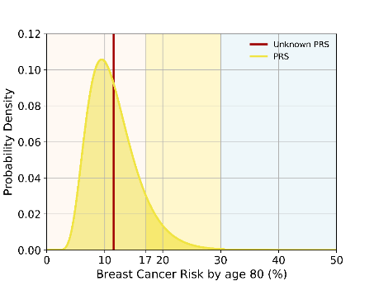
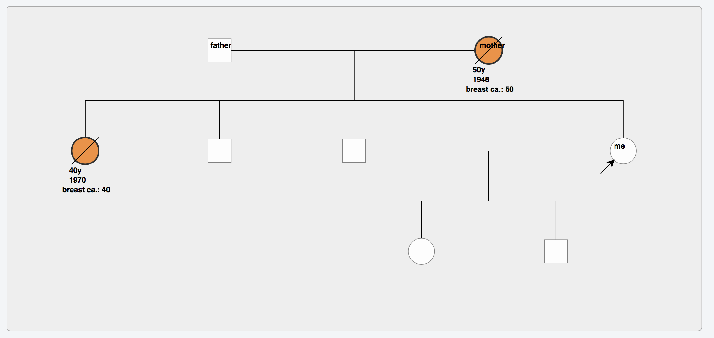
BOADICEA model: comprehensive risk prediction
Rare genetic Variants
Polygenic Risk Score
Family history
breast, ovarian
prostate, pancreatic
Other unobserved genetic effects
Lifestyle/hormonal/reproductive risk factors
Breast tumour characteristics: ER/PR/HER2
Population demographics
Segregation analysis methods
Lee et al, Genet Med 2019
Notes:
Earlier this year, we published the first comprehensive BC risk prediction model, an extension of the previous BOADICEA model which inludes …..

Slide 3
Rare genetic variants in BOADICEA
High risk
Moderate risk
Near-Population Risk
Lee et al, Genet Med 2016
Lee et al, Genet Med 2019

Slide 4
313 SNP Polygenic Risk Score
Breast Cancer Association Consortium (BCAC)
94,094 breast cancer cases and 75,017 control women
Validated in prospective cohorts
Explains 20% of Familial Risk
Mavaddat et al, AJHG 2019

Slide 5
Other breast cancer risk factors
Parity
Age at first live birth
Age at menarche
Age at menopause
BMI
Height
Alcohol use
Oral contraceptive use
Menopause hormone therapy use
Mammographic density
Lee A et al, Genet Med 2019
Notes:
And this is the list of risk factors….
More details are contained in the Lee et al.
What was shown in the ms is that by combining the effects all factors together, these can result to significant levels of risk stratification and re-classification both in the population, women with family history and women with rare moderate/high risk

Slide 6
Implementation: CanRisk tool https://canrisk.org
ASHG
ASHG2019
Active until end of October
Individual registration thereafter
Notes:
To make this easily accessible in clinicals we have implemented this in an easy to use interface called canRisk. So I would like you all to go to this webpage now. Because I cannot use both slides and the interface… I am using slides only.
You can log into the tool using the menu on the top right corner.
The username is ASHG and password ASHG 2019….

Slide 7
CanRisk tool https://canrisk.org
Quick
Guide
Start
session

Slide 8
CanRisk: Quick guide
Essential field
Completed
sections in green
Run risk calculation
Notes:
Before you enter any information. A brief explanation of how to navigate through the tool.
All the information is organized in sections: Personal detailes, lifestyle etc. you can click on each of the bars and they expand for you to enter the information.
The only Essential field is only age, through the date of birth…
Any completed versions are then highlighted in green.
Once all the information is input you can run the calcuations throught the “calculate” button at the bottom of the page…

Slide 9
Example: Family 1
Date of birth: 01/01/1979
Country: USA
Height: 173cm
Weight: 65kg
Alcohol: 1 glass wine daily
Age at menarche: 12
No oral contraceptives
Still having periods
No hormone replacement therapy (HRT)
Children: 1 daughter, born 2005
No mammograms
No other medical history (ignore section)
No PRS
CHEK2 +ve
CHEK2+

Slide 10
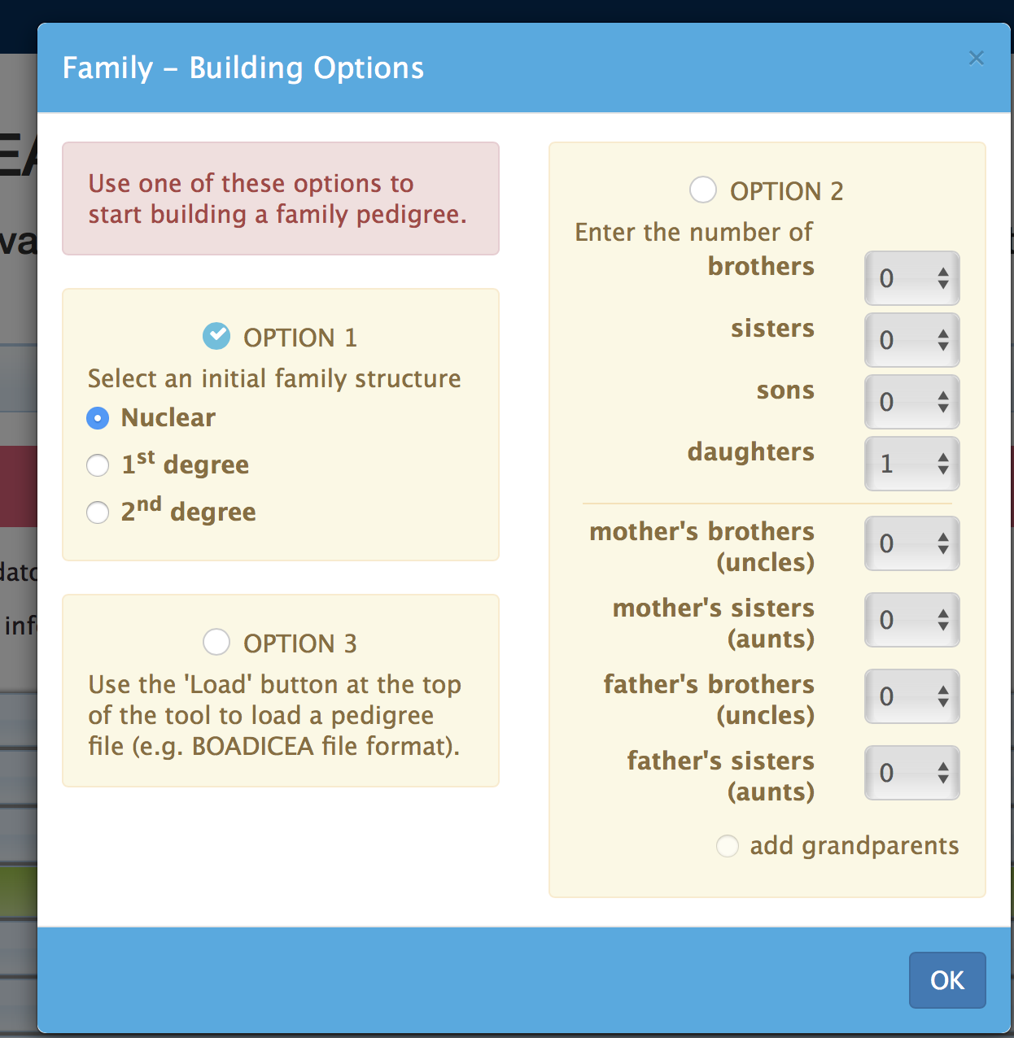
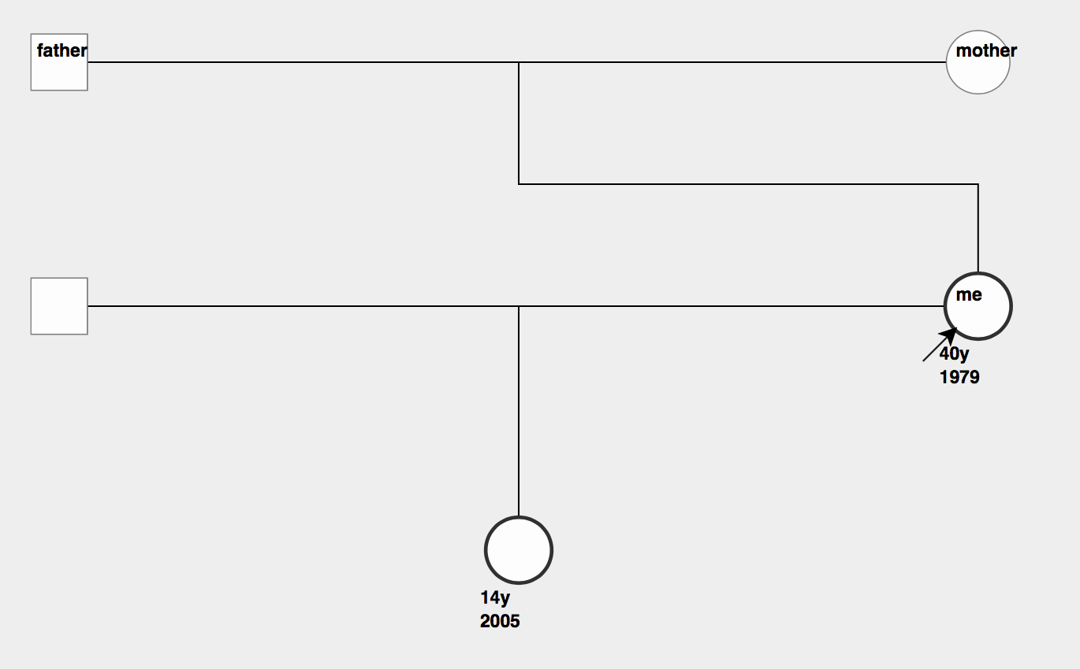
Example: Family 1, Family history section
Need to enter cancer diagnosis in mother

Slide 11
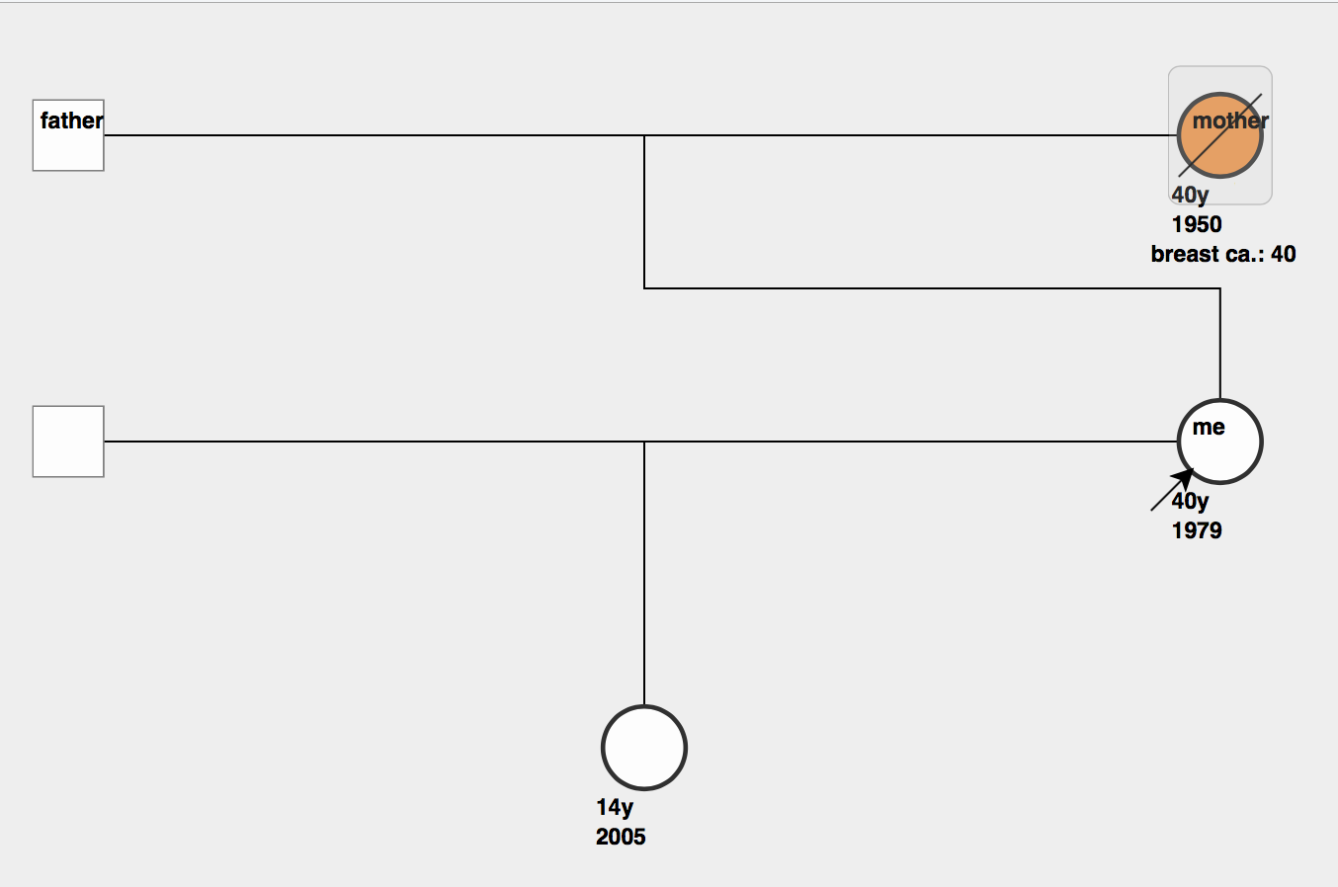
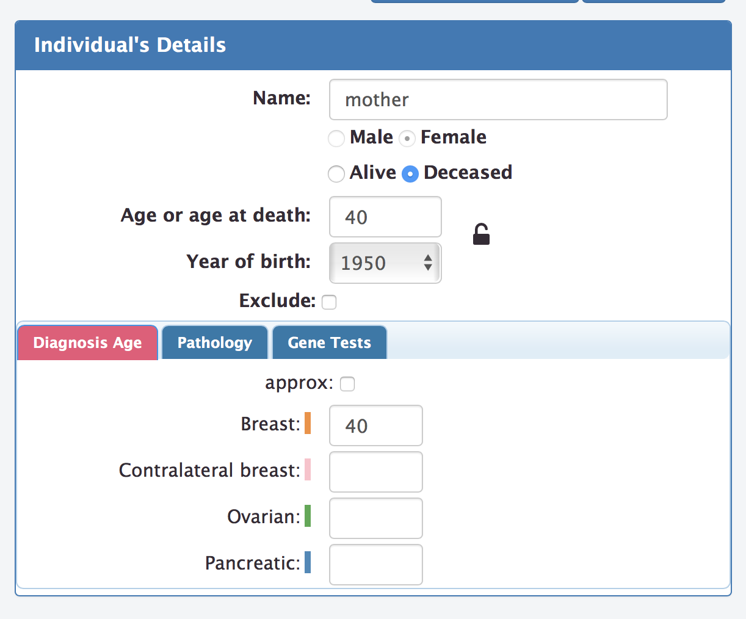
Example: Family 1, Family history section
Enter information on mother

Slide 12
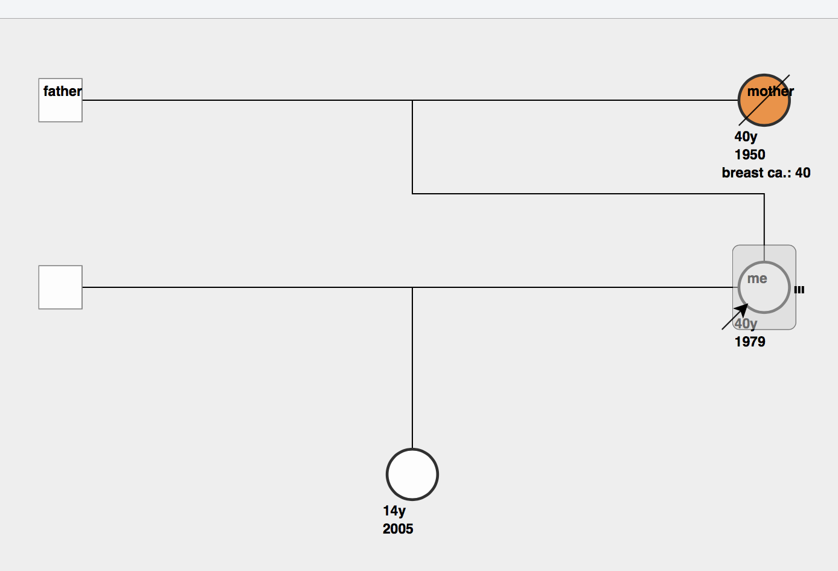
Example family 1: Adding mutation screening results, CHEK2 mutation carrier
Select proband (“me”)
Select “Gene Tests” tab

Slide 13
CanRisk: The results tab
Return to tool
Breast cancer risks
Mutation carrier probabilities
Risk categorization

Slide 14
NICE Breast Cancer Risk Classification Guidelines (U.K.)
Calculate risk
Study the results section
Discuss results in the context of NICE risk classification guidelines
30%
Predicted Risk
17%
8%
3%
10 year risk at
age 40 yrs
Lifetime risk
http://www.nice.org.uk/

Slide 15
Using Polygenic Risk Scores
SNP data: VCF files
Genotypes, dosages allowed
Download and save “vcf” example files from workshop site
Contains genotypes for 4 samples/individuals: “Low”, “Med”, “Mod”, “High”
Allows for different PRS versions. Own PRS? Please get in touch.
Notes:
Note the vcf file can contain genotype data for several samples. Need to select the name of the sample. Here the example has 4 samples named…

Slide 16
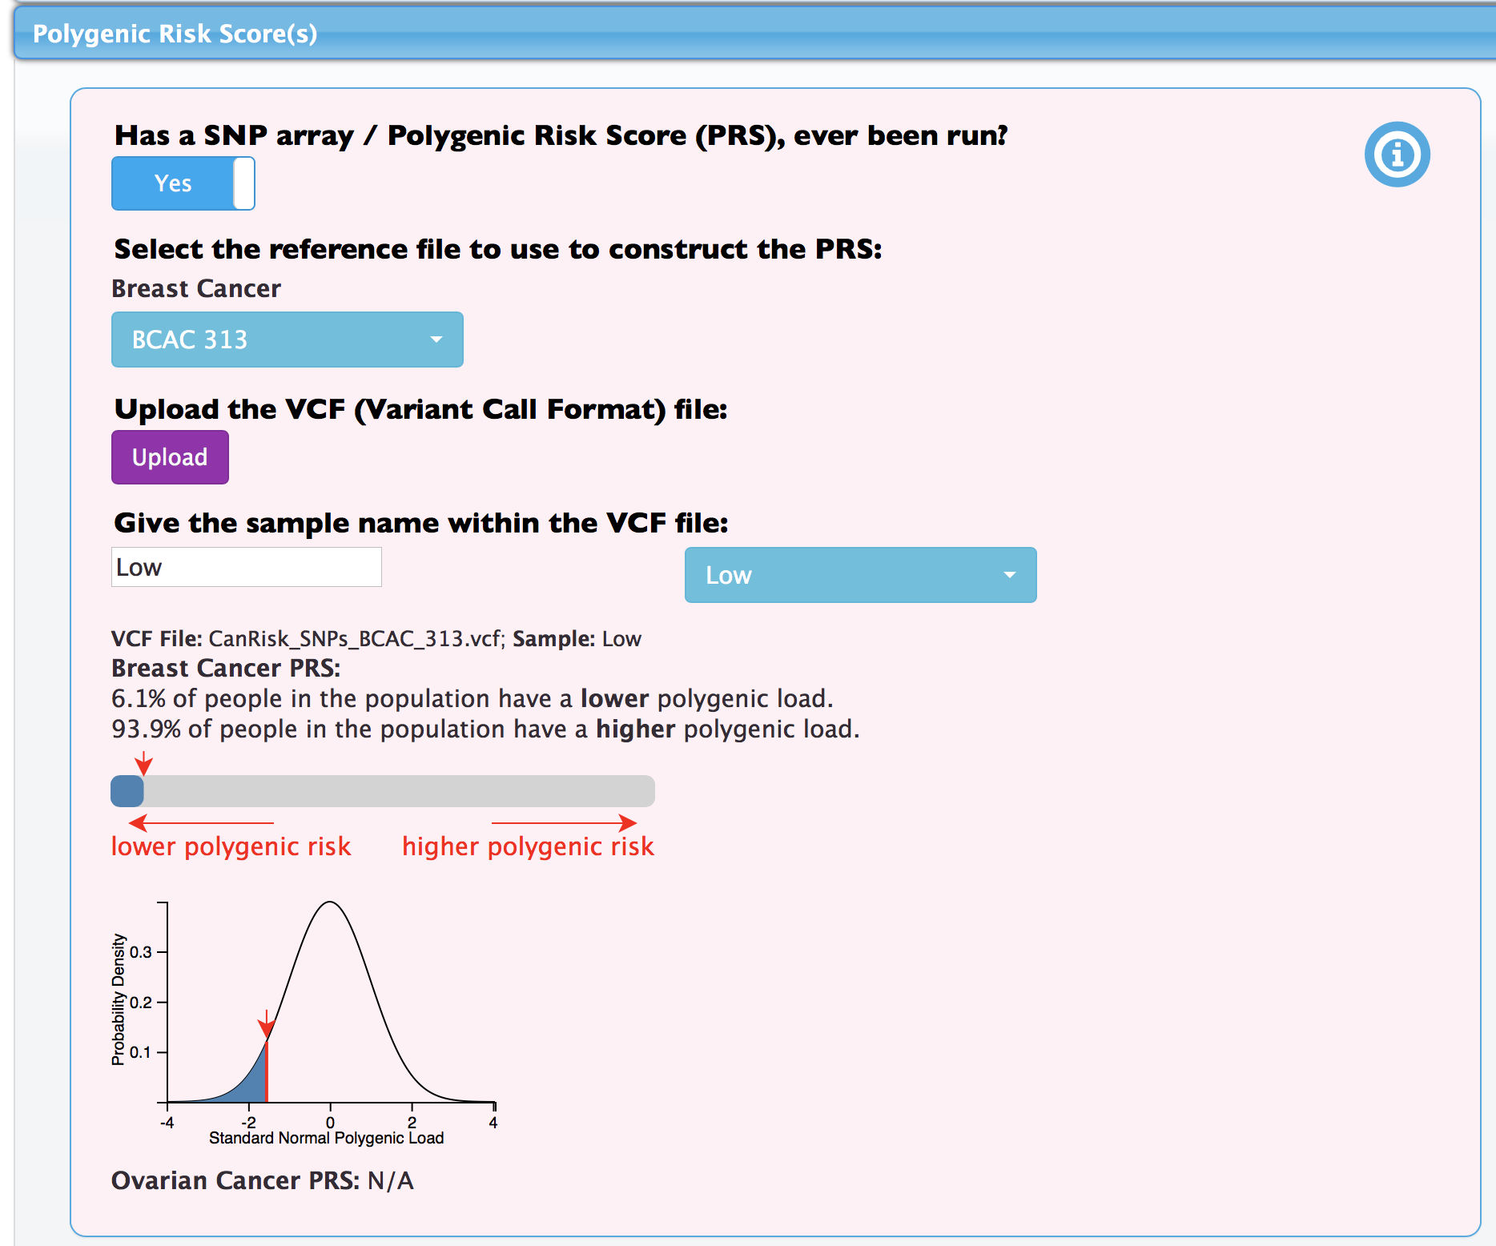
Example: Family 2. Same as family 1, CHEK2+ and “Low” PRS
Select “CanRisk Tool” to return to family
Upload VCF file
Select “Low” sample name in VCF file
CHEK2+
~6th percentile

Slide 17
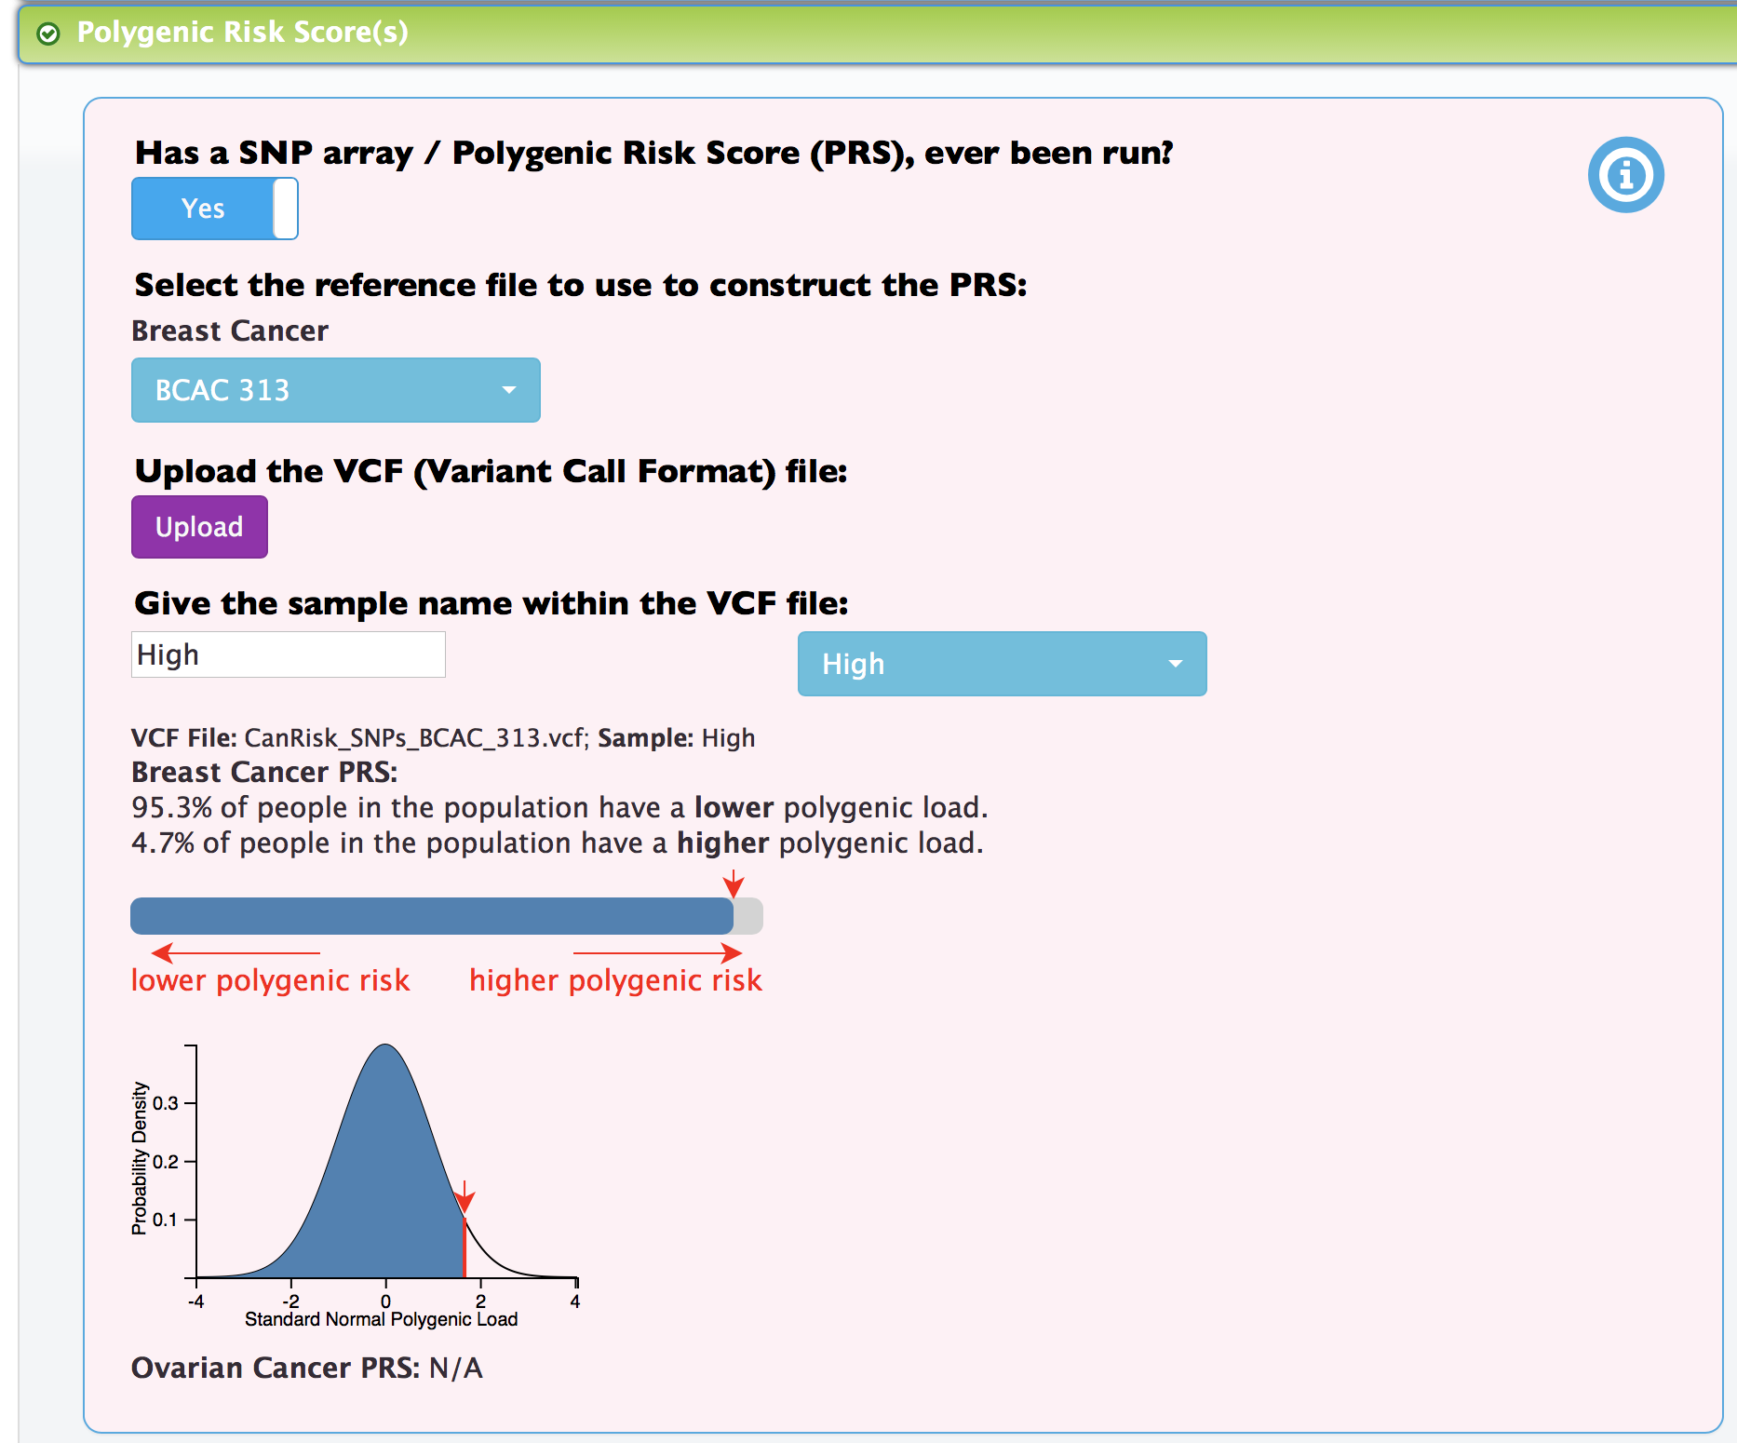
Example: Family 3. Same as Family 1, using High PRS
Select “CanRisk Tool” to return to family
Select “High” sample name in VCF file
CHEK2+
~95th percentile

Slide 18
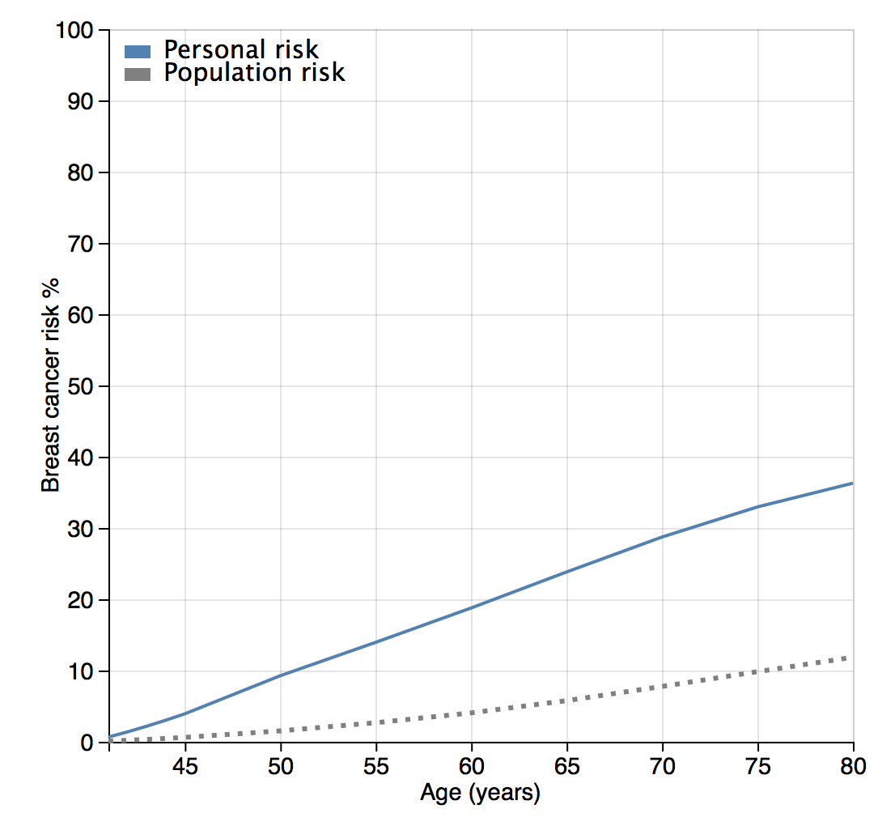
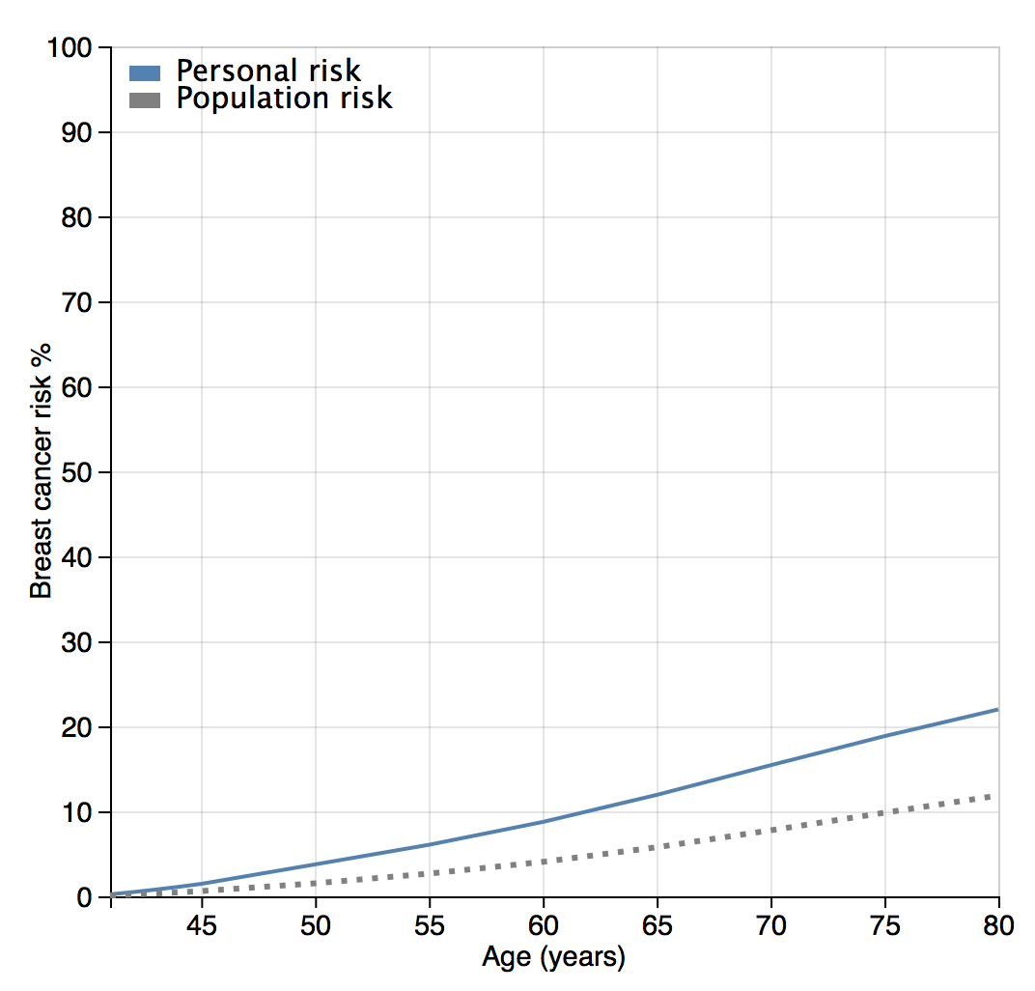
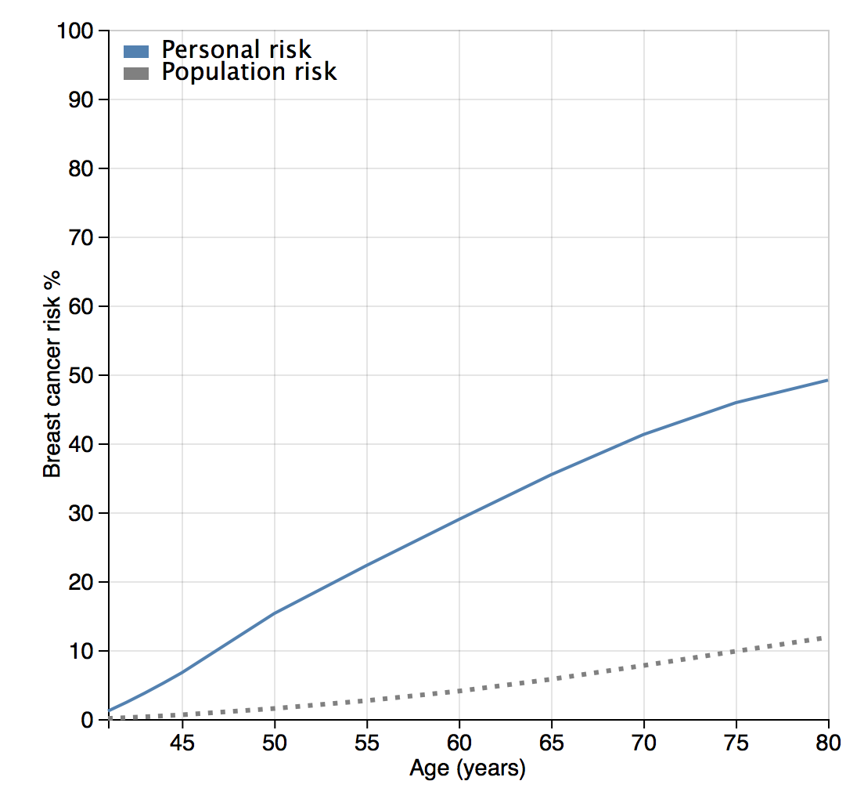
Discuss the classification based on predicted breast cancer risks….
Family 1: CHEK2+, No PRS
Family 2: CHEK2+, “Low” PRS
Family 3: CHEK2+, “High” PRS

Slide 19
Regulatory process, CE marking and general release
Use for clinical purposes requires regulatory approval
EU regulatory framework: In Vitro Diagnostic Medical Device
Submission to regulatory authority: any day….
Registration expected: end of October 2019
Individual registration required to use as a medical device (November release)
Conforms to EU standards only at the moment
Notes:
According to EU regulations this is classified as an IVDMD

Slide 20
Additional examples if time permits
Notes:
According to EU regulations this is classified as an IVDMD

Slide 21
Example: Family 4. Same as Family 1, No Genetic Tests
Date of birth: 01/01/1979
Country: USA
Height: 173cm
Weight: 65kg
Alcohol: 1 glass wine daily
Age at menarche: 12
No oral contraceptives
Still having periods
No hormone replacement therapy (HRT)
Children: 1 daughter, born 2005
No mammograms
No other medical history (ignore section)
No PRS
No other genetic tests
Select “CanRisk Tool” to return to family

Slide 22
Example: Family 5. Same as family 4 “Low” PRS
Select “CanRisk Tool” to return to family
Upload VCF file
Select “Low” sample name in VCF file
~6th percentile

Slide 23
Example: Family 6. Same as Family 4, using High PRS
Select “CanRisk Tool” to return to family
Select “High” sample name in VCF file
~95th percentile

Slide 24
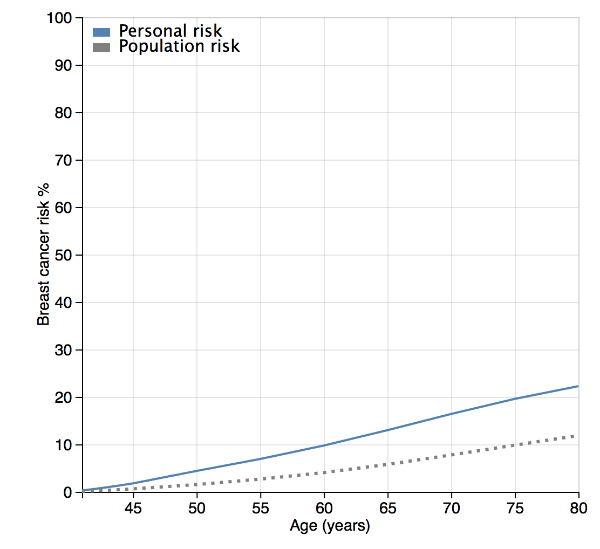
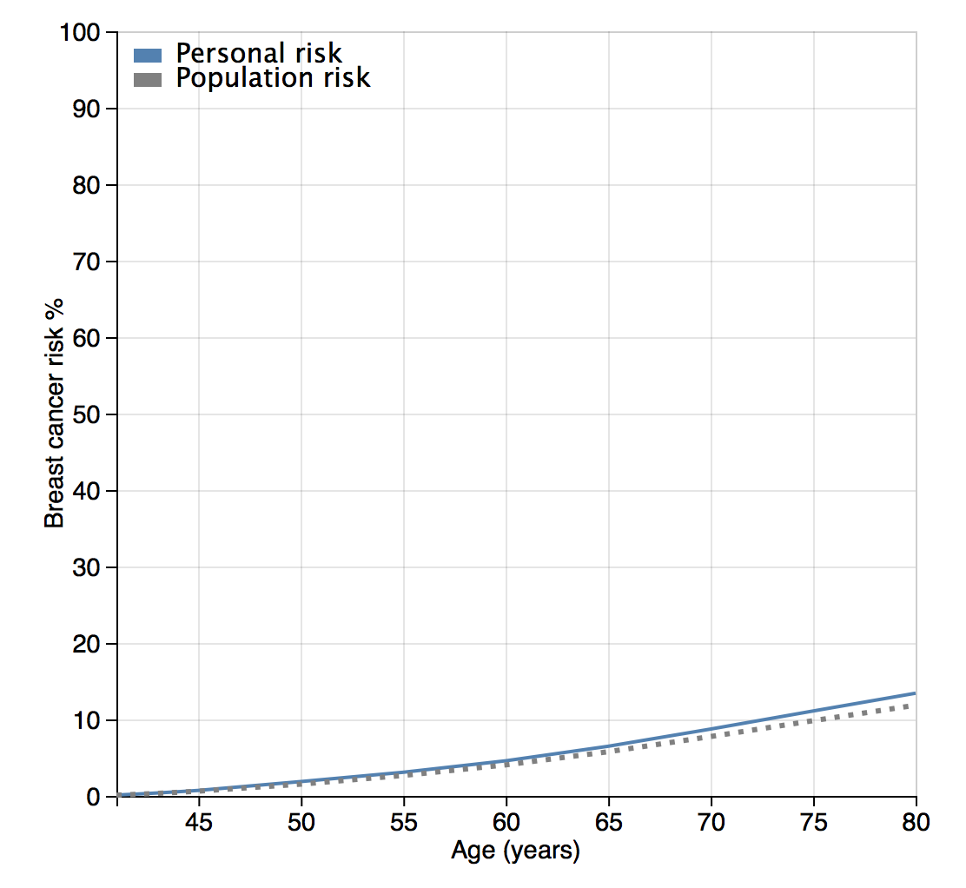
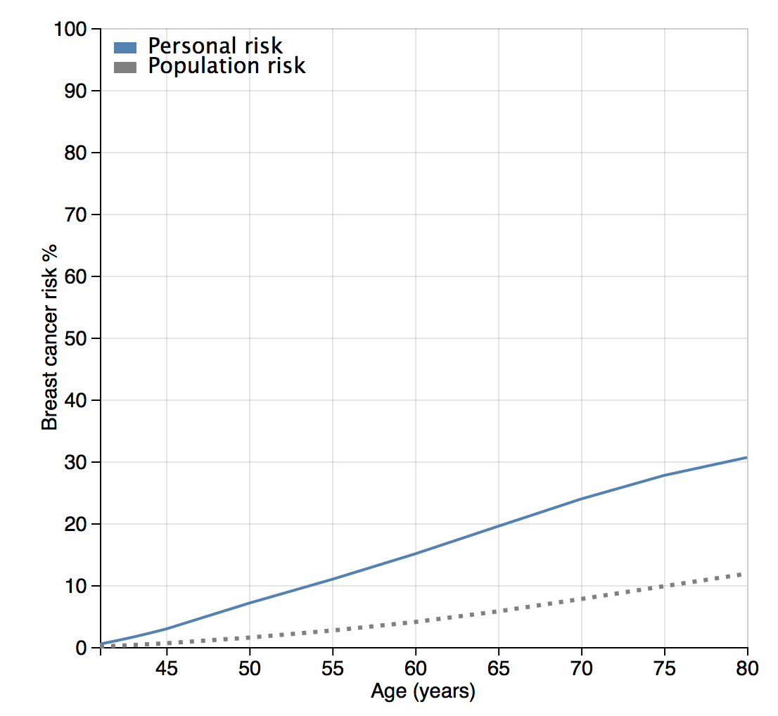
Discuss the classification based on predicted risks….
Family 4: No PRS
Family 5: “Low” PRS
Family 6: “High” PRS

Slide 25
Acknowledgments
University of Cambridge
Andrew Lee, Alex Cunningham, Tim Carver, Stephanie Archer, Simon Hartley, Daniel Barnes, Xin Yang, Lesley McGuffog, Goska Leslie, Nasim Mavaddat, Joe Dennis, Chantal Babb de Villiers, Tommy Nyberg, Renata Khoury, Paul Pharoah, Fiona Walter, Marc Tischkowitz, Douglas Easton
University of Manchester
D. Gareth Evans
National Cancer Institute
Montse Garcia-Closas
Amber Wilcox
Netherlands Cancer Institute
Marjanka Schmidt
Leiden University
Peter Devilee
Laval University
Jacques Simard
University of Toronto
Anna Chiarelli
Jennifer Brooks
Irene Andrulis
BCAC groups
CIMBA groups

